Slide 1
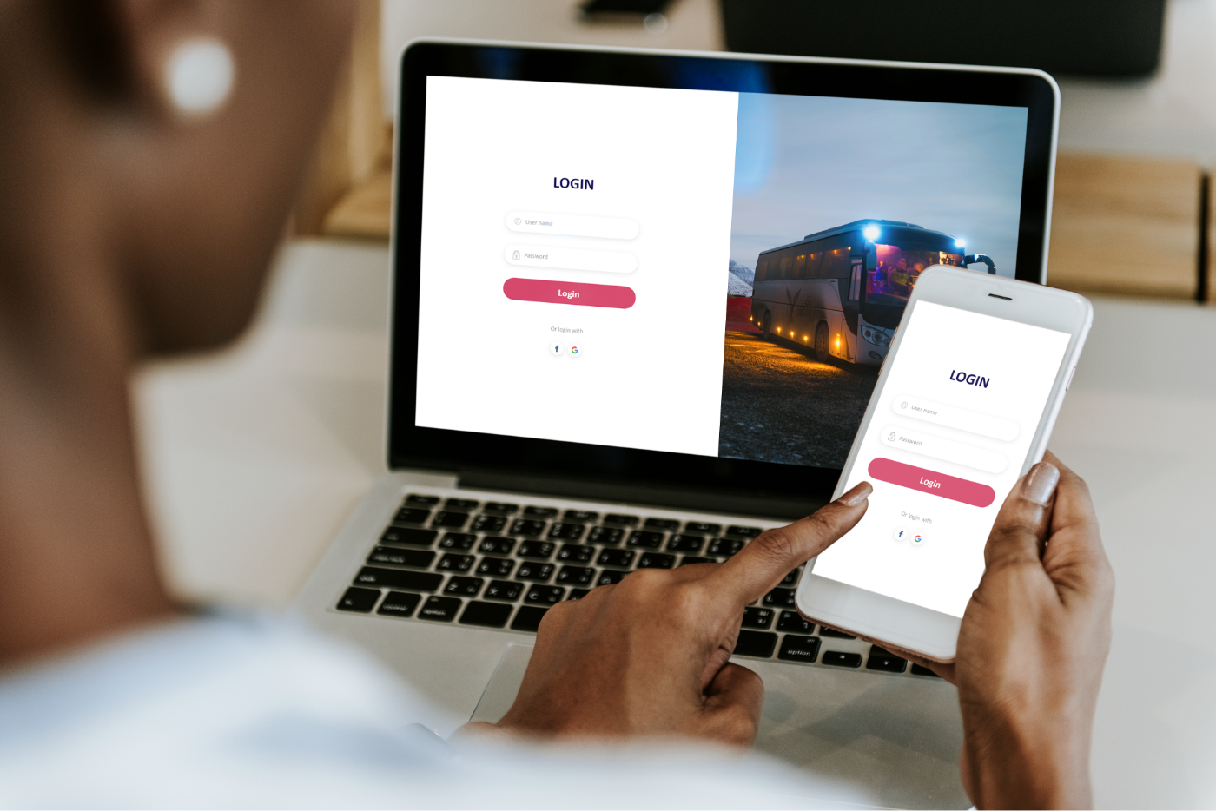

Presenter Name:
M. Vihith kumar reddy
Ch. Viswas
Faculty
DR. Madhusundar

Slide 2
ABSTRACT
The abstract introduces an innovative Bus Ticketing and Payment System designed to revolutionize bus travel by leveraging digital technologies.
Through features such as mobile applications, contactless payments, and real-time data analytics, the system aims to enhance the passenger experience and streamline operational efficiency.
Passengers can effortlessly book tickets, select seats, and make secure payments via smartphones, while GPS tracking provides real-time bus location updates.
By embracing cashless payment options and offering valuable insights through data analytics, the system improves security, reduces queuing times, and enables better decision-making for service providers.
Overall, the Bus Ticketing and Payment System represents a significant advancement in transportation, offering convenience, security, and efficiency for passengers and operators alike.

Slide 3
INTRODUCTION
The transportation sector has undergone significant advancements in recent years, spurred by the proliferation of digital technologies.
Among these innovations, the development of efficient Bus Ticketing and Payment Systems has emerged as a crucial element in enhancing the travel experience for passengers while optimizing operational processes for service providers.
Traditionally, bus ticketing relied on cumbersome paper-based methods, leading to long queues, ticketing errors, and inefficiencies in resource allocation. However, with the advent of digitalization, there has been a paradigm shift towards seamless, cashless, and convenient ticketing solutions.
This introduction explores the evolution of bus ticketing systems, highlights the challenges faced by traditional methods, and delineates the benefits and features of modern Bus Ticketing and Payment Systems in revolutionizing the transportation industry.
Through the integration of mobile applications, contactless payments, and real-time data analytics, these systems aim to redefine the way passengers interact with bus services while optimizing operational workflows for enhanced efficiency and customer satisfaction.

Slide 4

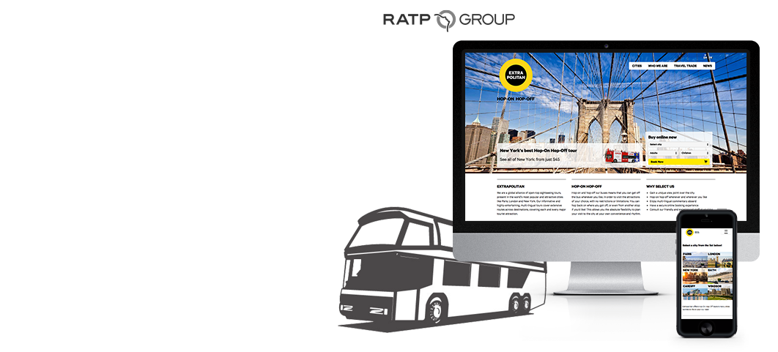

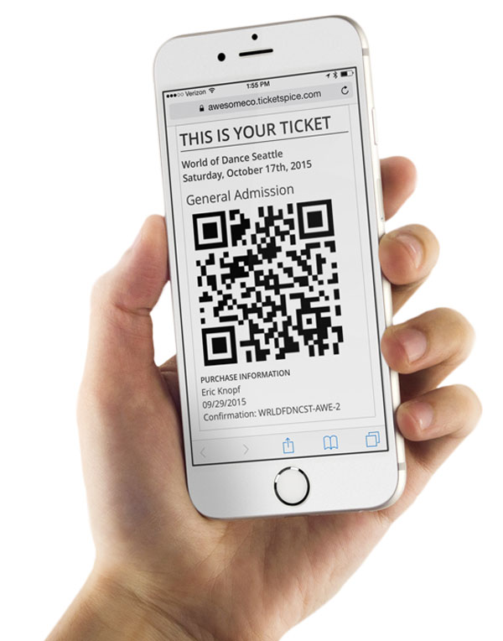

Slide 5
Primary objectives
The primary objective of the Bus Ticketing and Payment System is to enhance the overall passenger experience by providing a seamless, convenient, and secure ticketing and payment process. This includes enabling passengers to easily book tickets, select preferred seats, and make cashless payments using various digital platforms such as mobile applications or contactless payment methods. By prioritizing passenger convenience, the system aims to increase customer satisfaction, encourage repeat usage, and ultimately contribute to the growth and sustainability of the bus transportation industry.

Slide 6
Secondary objectives
Operational Efficiency: The Bus Ticketing and Payment System aims to streamline operational processes for bus service providers by automating ticketing, payment, and scheduling tasks.
Data-driven Insights: Another secondary objective is to leverage the data generated through the ticketing and payment system to gain valuable insights into passenger behavior, travel patterns, and demand fluctuations.
Fraud Prevention and Security: Ensuring the security of transactions and preventing fraudulent activities is another important objective of the Bus Ticketing and Payment System.
Integration and Interoperability: The system also aims to facilitate seamless integration with existing transportation infrastructure and interoperability with other modes of transport, such as trains or ferries.
Environmental Sustainability: Lastly, the Bus Ticketing and Payment System may have a secondary objective of promoting environmental sustainability by encouraging modal shifts from private vehicles to public transportation.

Slide 7
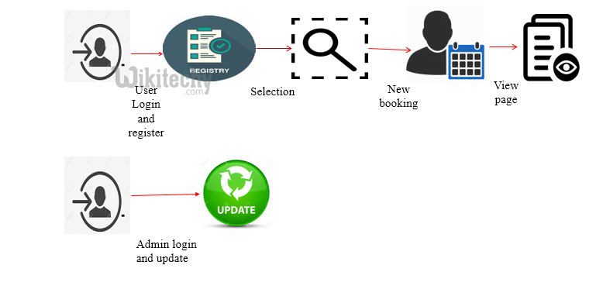
Architecture diagram

Slide 8
code
class BusTicketingSystem:
def __init__(self, destination, ticket_price):
self.destination = destination
self.ticket_price = ticket_price
def calculate_total_cost(self, num_tickets):
return self.ticket_price * num_tickets
# Main function
def main():
destination = "City A" # Destination of the bus route
ticket_price = 10 # Price per ticket
bus_system = BusTicketingSystem(destination, ticket_price)
print("Welcome to the Bus Ticketing and Payment System")
print("Destination:", destination)
print("Ticket Price:", ticket_price)
num_tickets = int(input("Enter the number of tickets you wish to purchase: "))
total_cost = bus_system.calculate_total_cost(num_tickets)
print("Total Cost for {} tickets: ${}".format(num_tickets, total_cost))
print("Please proceed with the payment.")
if __name__ == "__main__":
main()

Slide 9
output
Welcome to the Bus Ticketing and Payment System
Destination: City A
Ticket Price: 10
Enter the number of tickets you wish to purchase: 3
Total Cost for 3 tickets: $30
Please proceed with the payment.

Slide 10
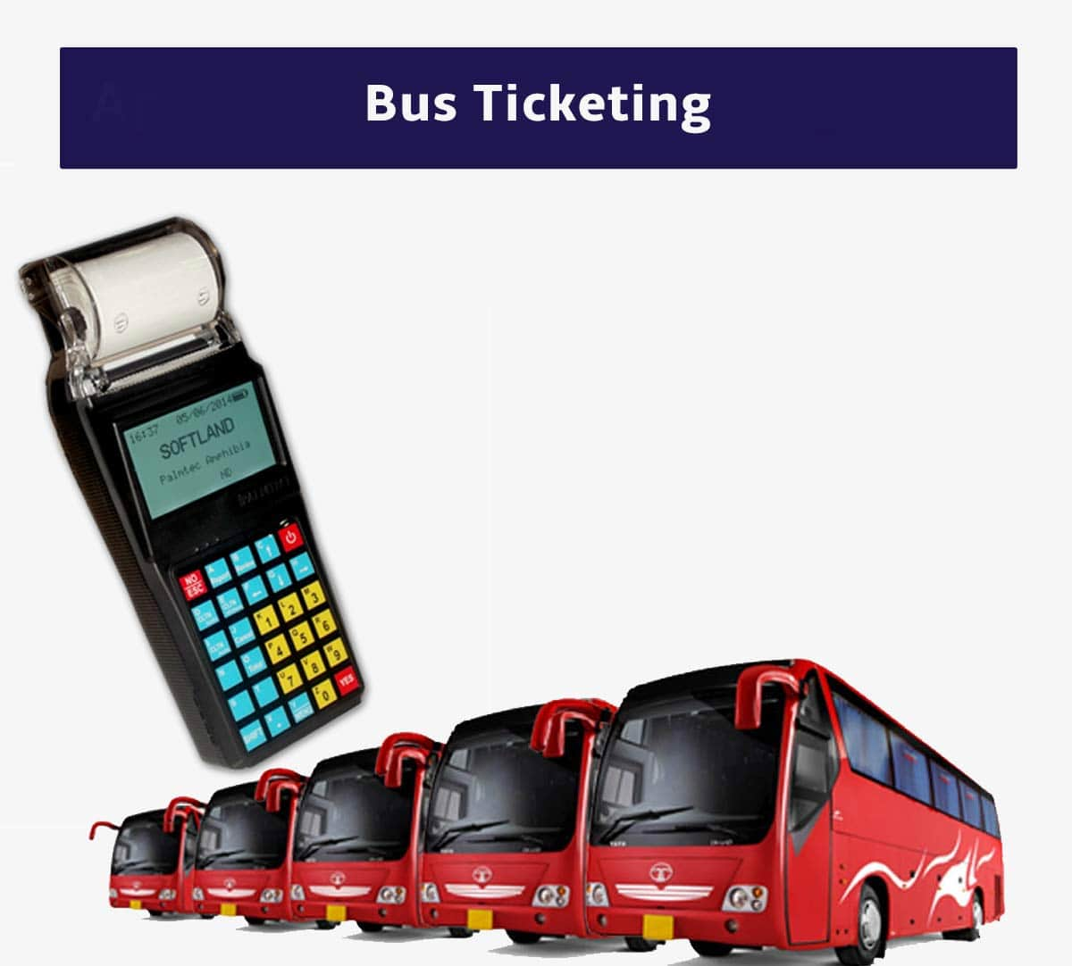

Slide 11
Result and discussion
outcomes across various dimensions. User adoption and satisfaction were high, as evidenced by increased usage statistics and positive feedback regarding the ease of use. Efficiency gains were notable, with faster transaction speeds and reduced queues observed at ticket counters and bus stops. Financially, the system demonstrated promising revenue increases and cost savings, contributing to a favorable return on investment. Operationally, the system streamlined processes for bus companies and provided valuable data insights for route planning. While security and reliability measures ensured user trust, discussions around future improvements highlighted opportunities for enhancing features, integrating with other services, and considering social and environmental impacts. Overall, the system's successful implementation underscores its potential to transform the bus ticketing and payment landscape while paving the way for further innovation and enhancement.

Slide 12
conclusion
In conclusion, the implementation of a modern bus ticketing and payment system offers numerous advantages for both passengers and transportation providers alike. By leveraging technology such as mobile applications and contactless payment options, the system streamlines ticketing processes, enhances passenger convenience, and improves operational efficiency. Passengers benefit from the ease of purchasing tickets online or through mobile apps, reducing wait times and providing real-time access to bus schedules. Transportation providers gain from increased accuracy in fare collection, reduced cash handling, and better insights into passenger demand patterns, leading to improved resource allocation and cost savings. Moreover, the integration of contactless payment options contributes to safety and hygiene, particularly in the context of public health concerns. Overall, investing in a comprehensive bus ticketing and payment system not only modernizes the transportation industry but also enhances the travel experience while promoting operational excellence.

Slide 13
references
Lee, Y., & Shin, B. (2012). Development of an integrated bus e-ticketing system for intercity transportation. International Journal of Smart Home, 6(4), 99-110.
Verma, A., & Singla, A. (2016). Design and development of smart card based bus ticketing system. International Journal of Advanced Research in Computer Science and Software Engineering, 6(6), 42-47.
Shukla, P. (2017). Design and implementation of cloud-based bus ticketing system. International Journal of Engineering Research and Applications, 7(4), 01-05.
Alves, T., & D'Andrea, A. (2019). A Study on the Acceptance of Contactless Payment Systems in Public Transportation: Evidence from Lisbon's Bus Network. Journal of Public Transportation, 22(1), 1-20.

Slide 14


